Slide 1
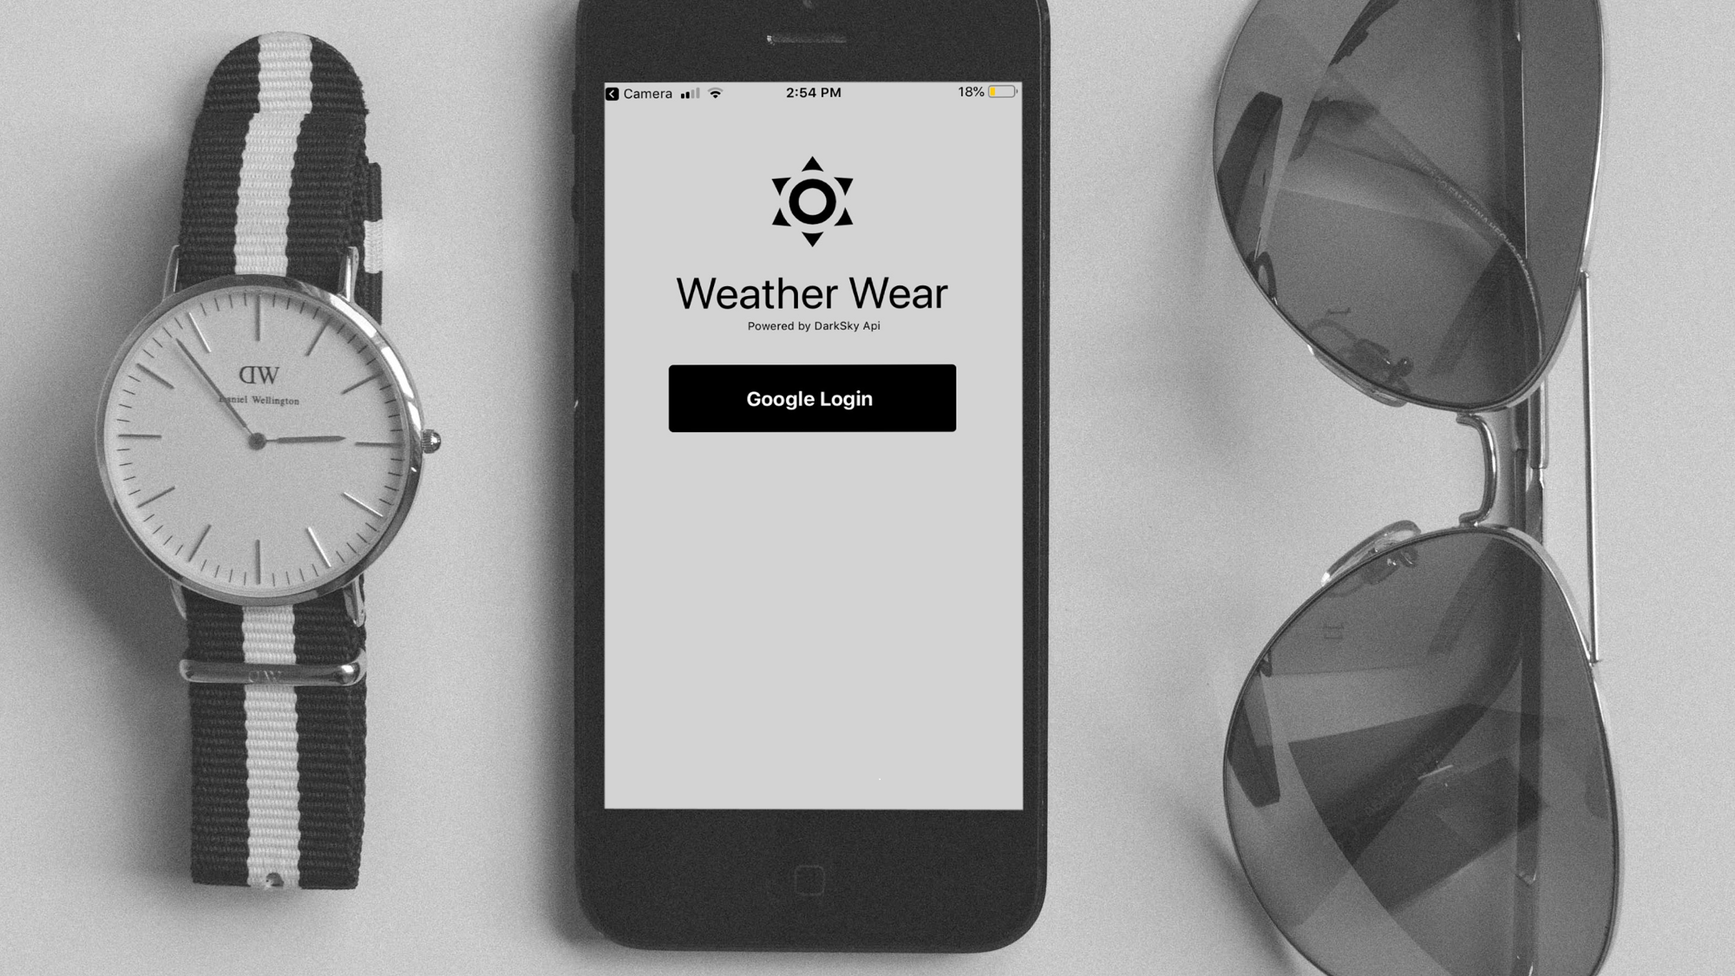
WeatherWear: Context-Aware Clothing Recommendations
Advisor / Client: Goce Trajcevski
SDMAY19-34: Nick Eaton, Will Parr, Tyler Witte, Christian Ehlen, Ethan Wieczorek, Nicus Hicks

Slide 2
Team Member Positions
Ethan Wieczorek: Lead Backend Developer
Nickolaus Eaton: Product Manager
Nicus Hicks: Director of Documentation and Reporting
Will Parr: Lead Frontend Developer
Tyler Witte: Lead Software Architect
Christian Ehlen: UI/UX and Quality Assurance Developer
Notes:
ALL OF TEAM
Ethan Wieczorek:
Role: Lead Backend Developer
Responsibilities:
Working with the group to make software architectural decisions.
Administrating and examining merge requests.
Designing and maintaining the recommendation algorithms.
Dealing with API synchronicity issues.
Working with Will to maintain working code throughout the merge process
Nick Eaton:
Role: Product Manager
Responsibilities:
Design of app and visuals
Design of testing-structure and product timeline
Documentation of product implementation decisions
User Interface/User Experience design.
Nicus Hicks:
Role: Director of Documentation and Reporting
Responsibilities: Create base pages to be added on, and do early research for future features. Additionally responsible for any upkeep and additions to the website.
Will Parr:
Role: Lead Frontend Developer
Responsibilities:
Develop user-facing features
Working with group to set up developer environments with Expo and Node.js.
Frontend external and internal API integration
Translate wireframes and designs into code
Working with Ethan to maintain working code throughout the merge process
Tyler Witte:
Role: Lead Software Architect
Responsibilities:
Designing and deploying build pipelines
Designing database layout and database management
System architectural decisions
Developer support
Christian Ehlen:
Role: UI/UX and Quality Assurance Developer
Responsibilities:
Designing the visuals of the app and ensuring that they are functioning on both platforms.
User Interface/User Experience design.

Slide 3
Problem Statement
Problem
Ambiguous and inefficient clothing selection for weather
Selecting clothing to pack for trip
Clothing appropriate for event types
Solution
Individual wardrobe tracking
Daily clothing suggestion
Weather, Calendar, and Location tracker
Notes:
NICK
Very common to see people dressing poorly for daily weather
Tshirts in cold/rain, coats on abnormally warm days.
Selecting clothing for trips and extended periods,
Selecting clothing for the days events (formal)

Slide 4
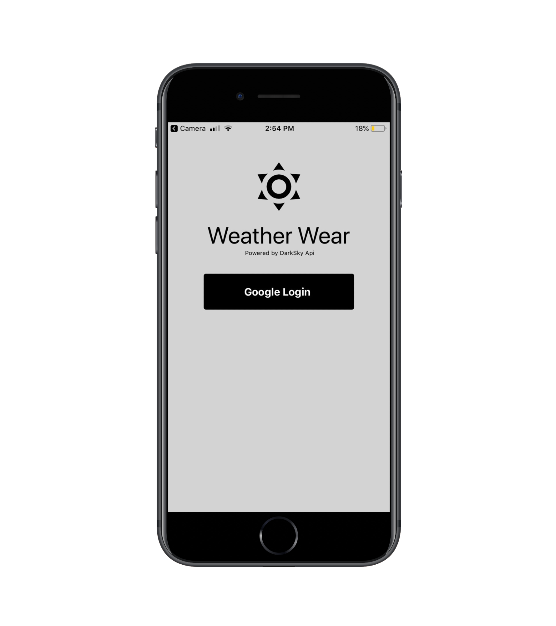
Summary
The WeatherWear mobile app, for iOS and Android, leverages React Native, the DarkSky API, and an Azure SQL DB alongside a clothing-recommendation system to give users outfit ideas for the current day or packing lists for upcoming trips.
Notes:
NICK

Slide 5
Market Survey - What makes this project unique?
Mobile Application
Cross-device compatible
Graphical User Interface (GUI)
Intuitive
Fast
Personalized to You
Wardrobe
Schedule
Many other applications focus on style or manual choice of outfits.
Our application chooses from your clothes based on weather and event data
Notes:
NICK

Slide 6
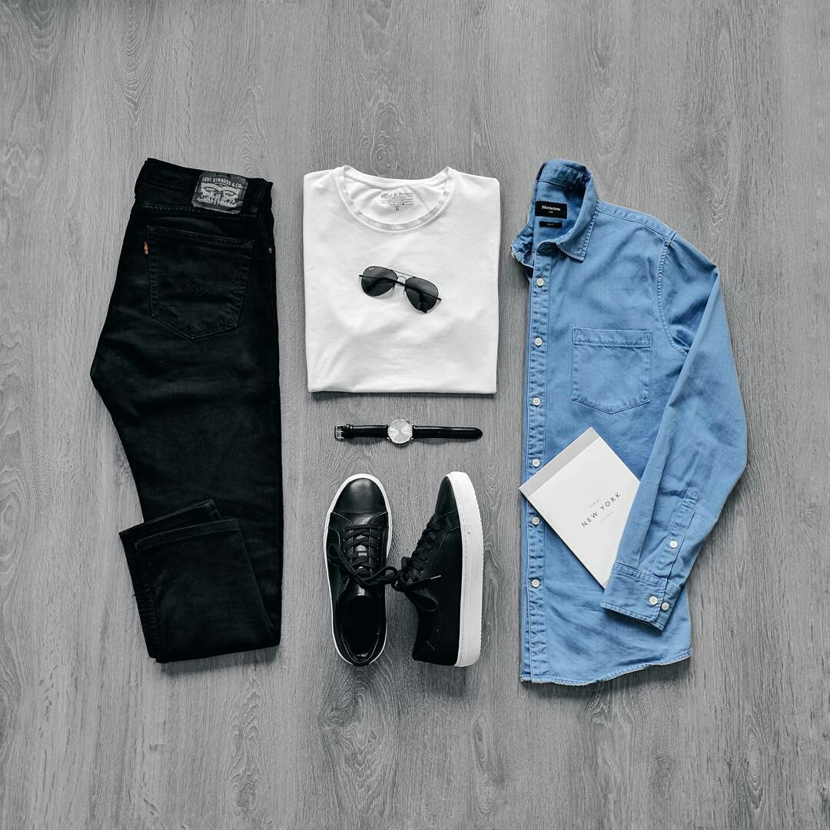
Functional Requirements
Google Authentication / Login
User Request for Clothing Items
Clothing Managed in Wardrobe
Context Matching for Weather
Cross-Device Compatible
Notes:
Christian
Next we will go over the functional requirements for the applications
User login
First, the user needs to be able to login and logout of the app because we are defining wardrobes by each user, not a general clothing recommendation
User request for clothing recommendation
Next, the user should be able to request clothing recommendations and have them appear personalized for that user
Add clothing and remove clothing from wardrobe selection
In order for the app to make recommendations, the user must be able to add clothing that they themselves own so that the app can make recommendations personalized to that user, not just in a general setting
Context Clothing
To satisfy the main requirement, these clothing recommendations should be based on the user’s local weather. This is what makes the app extremely beneficial to the user
Cross-Device Compatible
Then the final functional requirement is the ability for the app to run on both iOS and Android platforms

Slide 7
Non-functional Requirements
Scalability
Security
Usability
Performance
Maintainability
Notes:
Christian
Scalability - The database of the application must be scalable to ensure many users will be able to access the application and their wardrobes.
Security - Database must be secure to protect information about the users and their clothing
Usability - Moving on to usability the app needs to be accessible by all users and administrators, so all users can receive updates for clothing recommendations. Users will connect to the application via a mobile device and recommended clothing will be displayed as the weather and calendar are checked.
Performance - The application should generate a recommendation based off the weather and calendar events in less than 3 seconds, this ensures a smooth user experience
Maintainability- Database must be maintained to ensure proper updates via the weather and calendar. Also developers must design components that support maintenance and refactorization in the future
Availability - For the user to have a good experience, the application needs to be available 24/7 so that when the user requires context updates for their wardrobe
Reliability - The application must be able to recover loss of database and preserve user accounts and wardrobes, this ensures that under abnormal circumstances the application will be able to have a rollback point
Data Integrity - The clothing items stored in the database should only be able to be modified by the users or an administrator
Privacy - When viewing the database, the user data should be encoded to where a developer cannot tell how the program is recommending things to that user basically a modularization of user data

Slide 8
Design Plan and Objectives
Assumptions:
System supports multiple users
System supports multiple devices per user
User has consistent internet connection
Limitations:
System must be connected to internet to function
Users must have a smartphone or tablet
Notes:
Christian
So with our design plan and objects of our application we take a look at the assumptions and limitations.
Assumptions:
The system has to support multiple users running the application
The system has to support a single user accessing the application through multiple devices (User creates an account on one device, they can go and access their profile on a different device)
User needs to have a consistent internet connect to access external information like their weather and wardrobe
Limitations:
System needs to be connected to internet to function to be able to access the weather and user wardrobe
User needs to use a smartphone or tablet to run the app because it only runs on iOS and Android platforms

Slide 9
Project Milestones & Management
Phase 1: Planning
Aug 27 -Sep 25
Milestones:
Requirements
Solution Design
Use-cases & market survey
Phase 2: Development
Sep 26 - Apr 20
Milestones:
Technical Design
Mockups
Front End UI
User Login and Storage
Clothing Prediction
Stable Alpha
Stable Beta
Testing
Phase 3: Release
Apr 21 - May 5
Milestones:
Product Release
Improvements
Notes:
Christian
Phase 1: Planning
In this first phase this where we discussed solution design for creating context-aware clothing recommendations and the requirements we would need to set to solve this problem
Then after this we did some market research of similar applications and generated use cases on how the application should be navigated by a user
Phase 2:
Next in development this where we began choosing which technologies we would work with to satisfy the problem statement and requirements
Once this was all selected we began development with all these components listed here
Then at the end of development we move into stable alpha and beta then testing to finish it off.
Phase 3:
Now that beta and testing are over we move into product release and whatever improvements need to be made as time goes on

Slide 10
Technology Stack and Development Tools
DarkSky API
Azure Cloud Services
Google Firebase
Google Authentication
React Native
ExpressJS
Axios
Notes:
Will
Dark Sky
The Dark Sky API was used to retrieve weather data for daily clothing recommendation and trip planning. Dark Sky was selected for its pricing and ease of use. It was a strongly recommended API from mobile and Javascript developers, and had been widely used so resources were readily available.
Azure Cloud Services
Azure Cloud Services is used to host the Node.js backend server as well as the SQL database for the project. The decision to use Azure to host the server and database was based on Azure’s all-in-one resource management system, and in browser SQL Query Editor.
Google Firebase
User image storage and upload was managed through Google Firebase. Firebase was used for this for its Google Authentication support and file retrieval system.
Google Authentication
Google Authentication is used for user authentication. This decision was made because of the widespread use of Google in other applications and its cross application authentication availability.
React Native
The frontend was written in Javascript using the React Native framework. It was selected because of the ease of cross-platform development for Android and iOS.
ExpressJS
The backend server was written using the Express.js framework for Node.js. Express.js was selected to be used so that the entire project would be in one language, and based off available documentation and community support.
Axios
Axios is a JavaScript library that can be used to perform HTTP requests that is compatible with both the Browser and Node.js. This was used so that we could standardize the format of API requests on both the frontend and backend. The reason that Axios was the choice for the team was due to community support and that it is promise based.

Slide 11
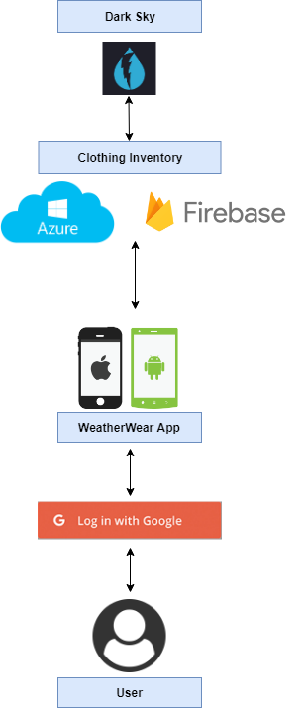
High Level Architecture
User Login with Google
WeatherWear mobile app
App interacts with Node.js backend
Azure SQL DB and Firebase authentication for user and clothing data
DarkSky API for detailed weather data
Notes:
Will
As you can see in the diagram, we plan to make a mobile application that runs on both android and ios
this application will interface with the google calendar api to find events in the user’s schedule,
As well as local weather data based on the users location through the dark sky weather api,
We will use this data
along with user’s preferences and clothing stored in the application’s firebase database to make context aware clothing recommendations on a day to day basis.
We have future intentions to expand this system to recommend for multi day trip planning

Slide 12
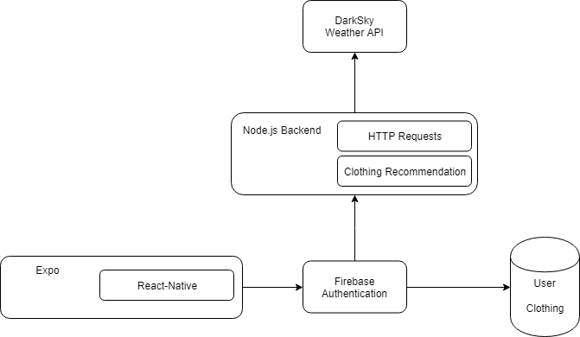
Functional Decomposition
WeatherWear app:
Trip Planning Request
Clothing Recommendation Request
Node.js Back-end:
RESTful API
Recommendation Algorithms
Weather:
Dark Sky API
React-Native-Weather
Clothing:
Azure SQL Database
Notes:
Will

Slide 13
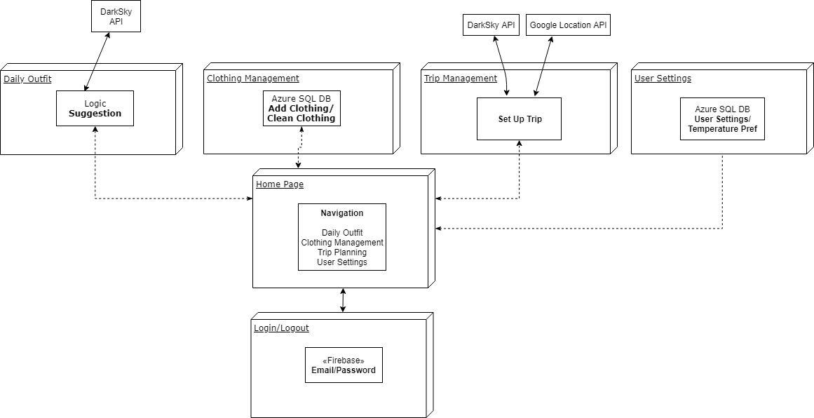
Detailed Design
Notes:
Will
First Screen- Login, new account
Home screen- Navigation to each seperate main screen
Daily Outfit- Using DarkSky weather and Google Calendar events, suggest a set of clothes
Clothing Management- Add, Remove clothing- register laundry. Deals directly with Firebase
Trip Manager- Set up a trip, deals with DarkSky and Google Calendar, using locations provided, to suggest clothes to bring
User Settings- Set personal preferences to temperature - Iowa user probably different “cold” than Florida user

Slide 14
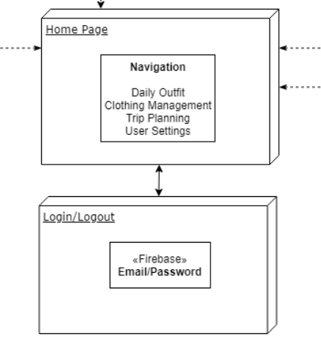
Login and Home Page (Front-End)

Slide 15
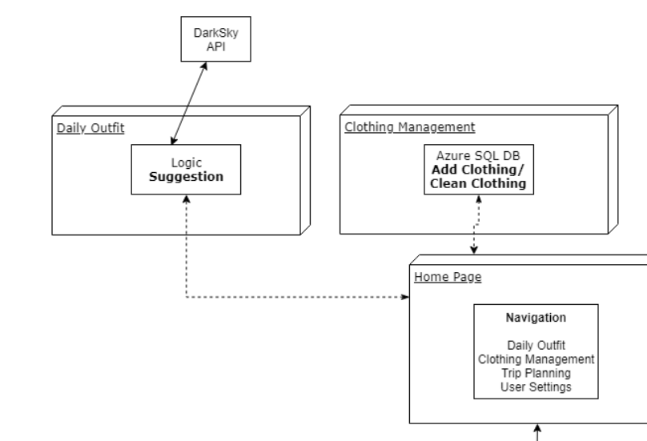
Daily Outfit and Wardrobe Management

Slide 16
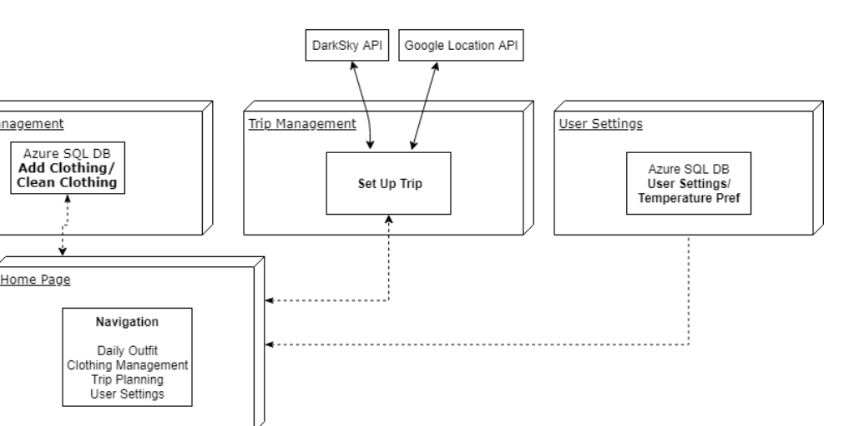
Trip Management and User Settings

Slide 17
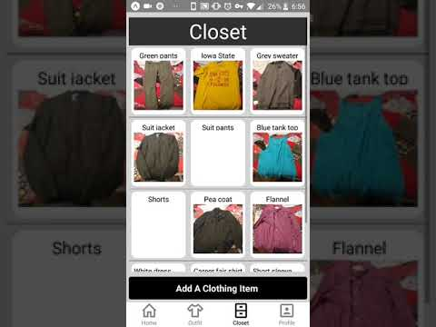
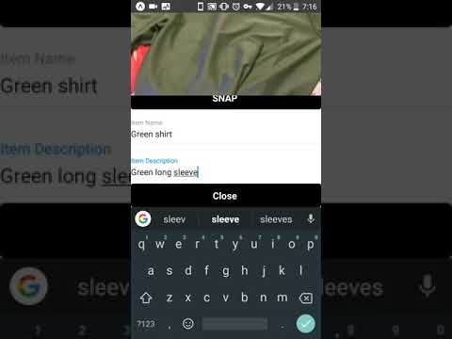
Demonstration - Login, Closet, Profile
Login, Closet, Profile
Add Clothing
Notes:
Ethan

Slide 18
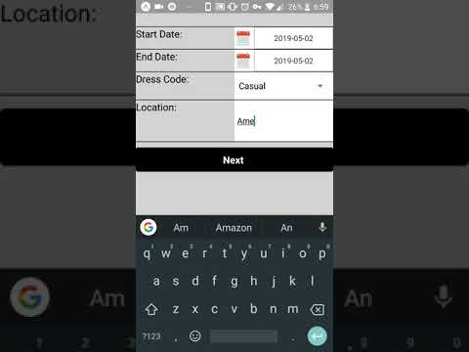
Demonstration - Outfit and Trip Planning
Notes:
Ethan

Slide 19
Applicable Standards & Best Practices
Agile Development Methodology : Efficient task scheduling per team member
Testing using Enzyme and Jest, Node.js unit testing
Git Monorepo with Dev branch
Team Members own unique positions & user stories
Merge request code reviews
Notes:
Nicus?
Agile used to encourage efficient, tailored tasks
Testing done using Jest with Enzyme for front end testing, Node.js unit testing for the back end
Git monorepo with dev branch
Unique responsibilities for each team member, with cooperation
Code reviewed before merging

Slide 20
Testing Plan
Testing Classifications:
Unit Testing
System and Integration Testing
Performance and Stress Testing
User Acceptance Testing
Beta Testing
Notes:
Nicus
The objective of this test plan is to provide a list of procedures to be referenced during the development of the WeatherWear system. Such a framework will assure software quality and security, and will assist in the development of the system.
Tested using Unit testing: Frontend and backend unit tests
system/integration testing: Ensuring results obtained from planned sources
performance/stress testing: Multiple calls and users at once
and beta testing, by giving access to other people

Slide 21
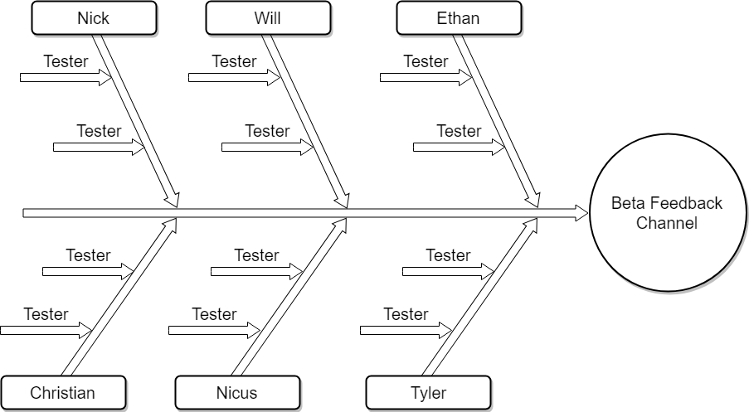
Notes:
Nicus

Slide 22
Test Plan - Functional
Integration | Validation
Location and Weather Data | Correct Location Correct Weather
Database Relations | Correct Clothing per user Update User Settings
Device cross-compatibility | iOS and Android both function the same
Clothing Categorization | Correct Categorization
Notes:
Ethan
Functional Testing
Location
Database Relations
Clothing uploading/downloading
User settings
Calendar integration
User keys
Device cross-compatibility
Weather Data
Clothing Categorization
Temperature ratings
Styles
Location and Weather
Geo - phone gets correct location from geo service within 300 meters
Weather - phone pulls correct weather for current location within 300 meters
Weather - phone pulls correct weather for any given location within 10 meters
DB Relations
Clothing - clothing is uploaded to the table under the correct user’s ID with 100% success when the Firebase service is up and attainable
Clothing - correct clothing is downloaded when a user requests it with 100% success when the Firebase service is up and attainable
User Settings - User can save a setting, restart the app, and retain the setting
Device CC
Every aspect of the application works the same on both android and iOS devices
Clothing Cat.
Clothing goes into the correct category for its temperature rating
Similar clothing items are categorized in the same style

Slide 23
Test Plan - Non-Functional
Integration | Validation
Performance | Authentication Recommendations
Security | Administrative functions Passwords Clothing access
Usability | Temperature settings
Compatibility | APIs
Notes:
Ethan
Non-functional Testing
Performance
Authentication Speed (< 1 second)
Recommendation Speed (< 2 seconds)
Security
Administrative Functions
Password security
Inability to access other user’s items
Usability
User biased temperature settings
Weather change notifications
Performance tracking and analytics
Compatibility
Dark Sky API
Firebase Database
Firebase Cloud Messaging
Authentication - creating an account and login in should return results within 1 second
Recommendations - A proper recommendation should be returned within 2 seconds
Administrative functions - Admin functions should only be accessible by users with admin privileges
Passwords - passwords should be secure and not stored in plain text
Clothing access - user’s can only access their own clothing from the database
Temperature settings - A user saving a personalized temperature setting should be reflected in the Outfit of the day
Notifications - The user’s phone polls for weather updates every 15 minutes and notifies the user of any important changes
APIs - The app is updated to provide compatibility with API changes within 2 days of any breaking changes

Slide 24
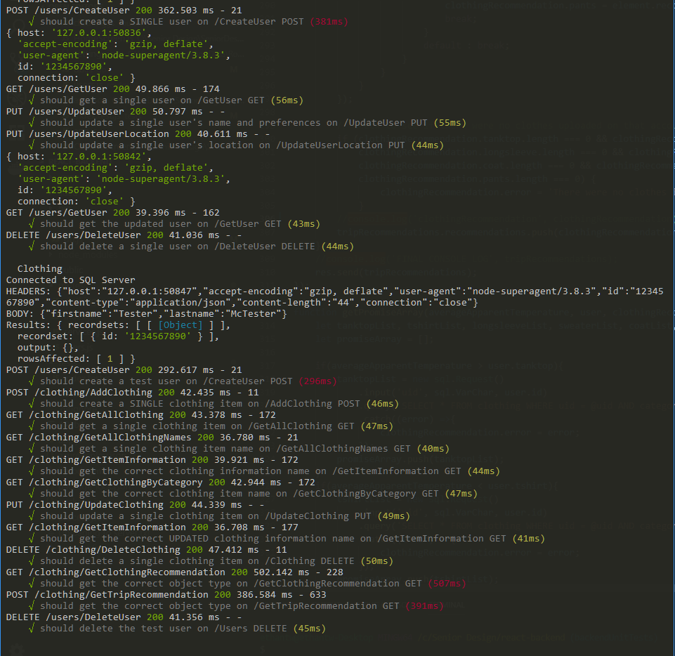
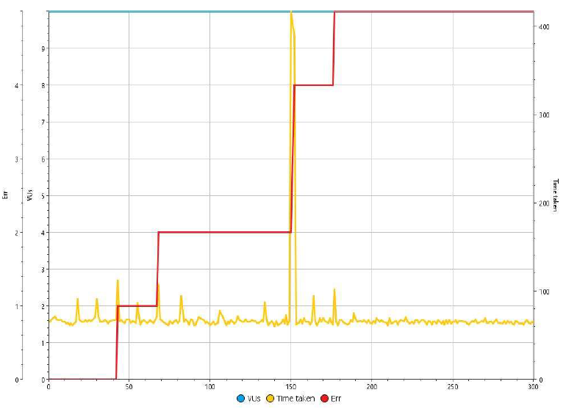
Results of Testing
System Load Testing using SMARTBEAR LoadUI
Tests run: 2741
Avg. Response Time: 72 ms
Notes:
Ethan

Slide 25
Risks & Mitigation
Account information
Mitigation: Google Login
Loss of local data
Mitigation: Data stored on Azure database
Secure access to data
Mitigation: Google Security/Authentication
Notes:
Tyler

Slide 26
Resource & Cost Estimate
Resources Required:
Deployment Platforms
Azure SQL database
Server system
Costs:
API query limits when exceeded
Database costs for security & size
Apple Developer License
Notes:
Tyler
Apple Developer Fee $99

Slide 27
Lessons Learned
Team Organization
Project Scope
System Development
Task Sharing
Risk Mitigation
Notes:
Tyler
After working as a group for an entire year we have overcome obstacles, grew as a team, and put all of our effort into creating a project that we feel meets our expectations for the project. We have learned how to mitigate issues that we could not foresee and how those issues affect the overall lifecycle of a project. Over the course of our project we have had to deal with issues both in and out of our control and how those issues affect a project timeline. By dealing with those issues we have learned how to overcome an issue out of our control and redesign the structure of our project to still meet the client requirements.
Throughout the semester we have had to grow as a team in order to succeed as best as we can. We have been assigning tasks to work on as pairs in order to grow our skill in areas where we are not currently the most successful by allowing our less experienced developers to learn from their peers. We learned how to best work and grow as a team and we believe we are fully prepared to take on the full time work force with our combined skills.

Slide 28
Future: Potential Directions
Style Recommendations
Integration with more diverse clothing types
E-Commerce/Advertising integration
Camera AI Clothing Recognition
Social Media Integration
Distributed Database
Notes:
Tyler

Slide 29
Q&A

